Slide 1
Information Retrieval Systems
Introduction to Information Retrieval Systems UNIT - I

Slide 2
AGENDA
Introduction to Information Retrieval Systems:
Definition of Information Retrieval System
Objectives of Information Retrieval Systems
Functional Overview
Relationship to Database Management Systems
Digital Libraries and Data Warehouses
Information Retrieval System Capabilities: Search Capabilities, Browse Capabilities, Miscellaneous Capabilities

Slide 3
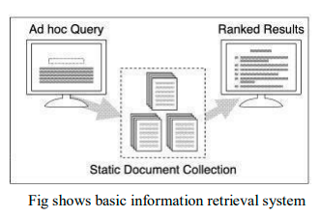
Information and Data
Information – Processing Data using some logic
Eg: Fetching data of theatres based on the movie name
Retrieval System Eg: (Database - Query)
Powerful PC with High Speed, Large Capacity

Slide 4
Introduction - What is IR?
System- centered View
IR is a branch of applied computer science focusing on the
representation,
storage,
organization,
retrieval, and distribution of information.
User-centered
IR involves helping users find information that matches their information needs.

Slide 5
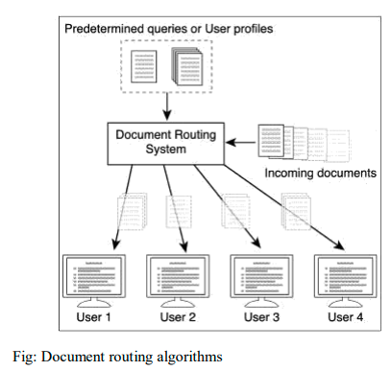
Document Routing and Filtering
An environment where corporate e-mail is routed based on predefined queries to different parts of the organization (i.e., e-mail about sales is routed to the sales department, marketing e-mail goes to marketing, etc.) is an example of an application of document routing.

Slide 6
Definition of IRS
It is system that is capable of storage, retrieval and maintenance of info.
It is a combination of images, videos, audio or any other objects.
In IRS every smallest component represented by “ITEM”
An IRS consists of s/w program that facilitates a user in finding the info.

Slide 7
Objectives of IR
Its main objective is to minimize is how well it can minimize the user overhead for a user to find the needed info.
Overhead from user's perspective is the time required to find the info needed, excluding the time for actually reading the relevant data.
Thus, search composition, search exec., & reading non- relevant items are all aspects of IR overhead.

Slide 8
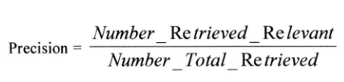

Measures
To minimize the overhead of a user two major measures :
Precision: The ability to retrieve top-ranked documents that are mostly relevant.
Recall: The ability of the search to find all of the relevant items.

Slide 9
Measures
Precision is directly affected by retrieval of non-relevant and drop a no close to zero
Recall is not affected by non-relevant items

Slide 10
Functional Overview
Four major IRS Functional Process
Item Normalization
Selective Dissemination of Information
Document Database Search, and an Index
Database Search - Index Files.

Slide 11
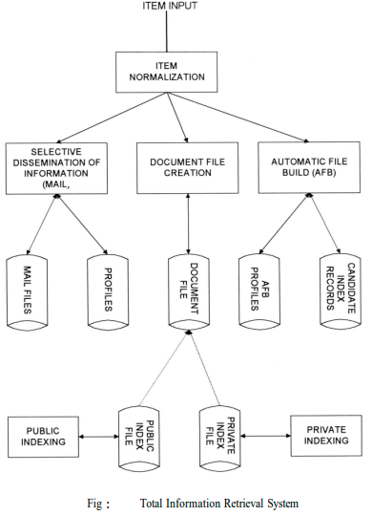

Slide 12
1) Item Normalization
1. Any integrated system normalize the incoming items to normal standard
(in-short Language encoding and file formats)
2. Logical restricting of item
(in-short Zoning )
3. Create searchable data structure
(in-short Indexing)

Slide 13
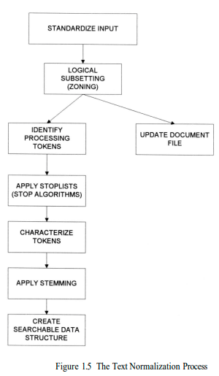

Slide 14
Text Normalization Process
Standardized Input
The input takes in different external formats.
I.e.., translation to be system understandable formats.
Zoning (logical restricting)
Parse the item
Typical item is sub divided into zones.
Each zone will consists of Title, Author, Abstract, Main Text ,Conclusion , References , Country , …etc

Slide 15
Text Normalization Process
Identify Processing Tokens
Send to data processing tokens
Find the user interested concept, input symbols categories into
Valid word symbols(alphabetic characters, numbers)
Inter word systems(blanks, semicolons)
Special processing symbols(hyphens -)

Slide 16
Text Normalization Process
Stop Algorithm
Finding the constant of eliminating the tokens which not required for searchable processing.
Constant = Frequency x rank
Any word(1 or 2) found in almost any item
Characterized tokens
Specific word characters (eradicate ambiguity) – one word(2 purposes) is used many times .
Stemming Algorithm
Using the unique words to eradicate the ambiguity(Non –Repetitive of similar token).
Efficiency increase of IRS
Creates the searchable DS

Slide 17
2) Selective Dissemination
It provides the capability to dynamically compare newly received items.
They are against the standard statements of users, delivers the whose interest matches with contents.
Which Contains
Search process
User statements of interest
User mail files
Standardize Input
Input – different external format
Translated to system formats

Slide 18
3) Document Database Search
It provides the capability for a query to search against all the items received by system
Which Consists
Search Process
User entered queries
Document database(all items received)
Document File
Document is created with the retrieval data with 2 types of indexing
Private file (private indexing)
Public file(public indexing)

Slide 19
Index database Search
When an item is searched and user wants to save it for future then its process is based on index process
In this process the user can logically store an item in a file
In index the DB Search process provides the capability to create index and searched
Here are 2 classes of files
Public index files
Private index files

Slide 20
4) Automatic File Build(AFB)
To assist the user in generating indexes especially the professional indexes, the system is called AFB
Automatic File Build (AFB)
Final Particular records (candidate index records with profiles)

Slide 21
Relationship to Database Management System
Two major categories of systems available to process items:
Information Retrieval Systems (IRS)
An Information Retrieval System is software that has the features and functions required to manipulate “information” items.
Information is fuzzy text. The term “fuzzy” is used to imply the results from the minimal standards or controls on the creators of the text items.
Structured data is well defined data (facts) typically represented by tables.
There is a semantic description associated with each attribute within a table that well defines that attribute.
The results are frequently tabulated and presented in a report format for ease of use.

Slide 22
Relationship to Database Management System
Data Base Management Systems (DBMS)
DBMS that is optimized to handle “structured” data.
a search of “information” items has a high probability of not finding all the items a user is looking for.
The user has to refine his search to locate additional items of interest. This process is called “iterative search.”
An Information Retrieval System gives the user capabilities to assist the user in finding the relevant items, such as relevance feedback
The results from an information system search are presented in relevance ranked order.

Slide 23
Relationship to Database Management System
One of the first commercial databases to integrate the two systems into a single view is the INQUIRE DBMS.
This has been available for over fifteen years.
A more current example is the ORACLE DBMS that now offers an imbedded capability called CONVECTIS, which is an informational retrieval system that uses a comprehensive thesaurus which provides the basis to generate “themes” for a particular item.
CONVECTIS also provides standard statistical techniques.
The INFORMIX DBMS has the ability to link to RetrievalWare to provide integration of structured data and information along with functions associated with Information Retrieval Systems

Slide 24
Digital Libraries and Data Warehouses(or Data Marts)
Libraries have been in existence since the beginning of writing and have served as a repository of the intellectual wealth of society.
As such, libraries have always been concerned with storing and retrieving information in the media it is created on.
As the quantities of information grew exponentially, libraries were forced to make maximum use of electronic tools to facilitate the storage and retrieval process.
With the worldwide interneting of libraries and information sources (e.g., publishers, news agencies, wire services, radio broadcasts) via the Internet, more focus has been on the concept of an electronic library.
During this time the terminology evolved from electronic libraries to digital libraries.

Slide 25
Digital Libraries and Data Warehouses(or Data Marts)
As the Internet continued its exponential growth and project funding became available, the topic of Digital Libraries has grown.
Indexing is one of the critical disciplines in library science and significant effort has gone into the establishment of indexing and cataloging standards.
Another important library service is a source of search intermediaries to assist users in finding information with the proliferation of information available in electronic form, the role of search intermediary will shift from an expert in search to being an expert in source analysis.
Searching will identify so much information in the global Internet information space that identification of the “pedigree” of information is required to understand its value.
This will become the new refereeing role of a library.

Slide 26
Issues in Digital library
It has ignored the issues of unique identification and tracking of information required by the legal aspects of copyright that restrict functions within a library environment.
Intellectual property rights in an environment that is not controlled by any country and their set of laws has become a major problem associated with the Internet.
The conversion of existing hardcopy text, images (e.g., pictures, maps) and analog (e.g., audio, video) data and the storage and retrieval of the digital version is a major concern to Digital Libraries.
IRS are starting to evolve and incorporate digitized versions of these sources as part of the overall system.
But there is also a lot of value placed on the original source (especially printed material) that is an issue to Digital Libraries and to a lesser concern to IRS.

Slide 27
Digital Libraries and Data Warehouses(or Data Marts)
Data mining (originally called Knowledge Discovery in Databases - KDD) is a search process that automatically analyzes data and extract relationships and dependencies that were not part of the database design.
Most of the research focus is on the statistics, pattern recognition and artificial intelligence algorithms to detect the hidden relationships of data.
In reality the most difficult task is in preprocessing the data from the database for processing by the algorithms.

Slide 28
Digital Libraries and Data Warehouses(or Data Marts)
A data warehouse is focused solely on structured databases.
A data warehouse consists of the data, an information directory that describes the contents and meaning of the data being stored, an input function that captures data and moves it to the data warehouse, data search and manipulation tools that allow users the means to access and analyze the warehouse data and a delivery mechanism to export data to other warehouses, data marts (small warehouses or subsets of a larger warehouse), and external systems.
a data warehouse is more focused on structured data and decision support technologies.
In addition to the normal search process, a complete system provides a flexible set of analytical tools to “mine” the data.

Slide 29
IRS - Capabilities
Search capabilities
Browse capabilities
Miscellaneous capabilities
Standards

Slide 30
1) Search Capabilities
The objective of the search capability is to allow for a mapping between a users specified need and the items in the information database will answer the need.
It can consist of natural language and Boolean logic
This will allow user to indicate the importance of search items in either a Boolean or natural language
Based upon the algorithm used in a system many different functions are associated with the system understanding the search statement.

Slide 31
1) Search Capabilities
The functions define the relationship between the terms in the search statements:
Boolean logic
Proximity
Contiguous word phrases
Fuzzy searches
Term masking
Numeric & Data Ranges
Concept / Thesaurus expansion
Natural Language Queries

Slide 32
Boolean Logic
It allows user to logically relate multiple concepts together to define the information needed.
Boolean(logical) operators are AND, OR, NOT
These are implemented using
Set interaction
Set union
Set difference

Slide 33
Boolean Logic
Given the following natural language query statement where the importance of a particular search term is indicated by a value in () between 0.0 ,1.0 with 1.0 being the important.
Example:
Find articles that discuss automobile emissions(.9) or sulfur dioxide(.3) on the farming industry.
the system would recognize item selection process that automobile emissions are far more important than items discussing sulfur dioxide problems
Based upon the algorithms used in the system many different functions are associated with the systems understanding the search statements.

Slide 34
Boolean Logic
Example: A special type of Boolean search “M of N”
“Find any item containing any two of the following terms: “AA,” “BB,” “CC.”
This can be expanded into a Boolean search that performs an AND between all combinations of two terms and “OR”s the results together
(AA AND BB) OR
(AA AND CC) OR
(BB AND CC).

Slide 35
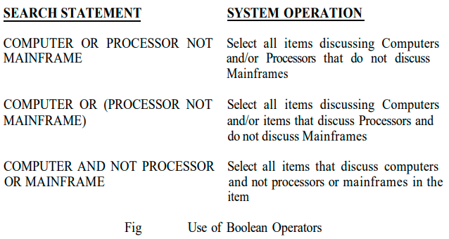
Example

Slide 36
Proximity
It is used to restrict the distance allowed within an item between two search terms
It is used to increase the precision of a search
Typical form of proximity is
TERM1 within “m” units of TERM2
The distance operator “m” is an integer number and units are in characters , words, sentences or paragraphs.
He special base of proximity operator is Adjacent(ADJ) operator that normally has a distance operator of one and a forward only direction.
Ex: COMPUTER ADJ DESIGN
It find items as mentioned like COMPUTER DESIGN on a window but not discussing DESIGN COMPUTER

Slide 37
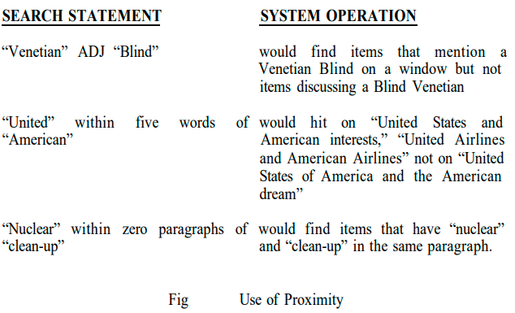
Example

Slide 38
Contiguous Word Phrases - CWP
Way of specifying both query term and a special search operator.
CWP is two or more words that are treated as a single semantic.
A CWP also acts like a special search operator that is similar to the proximity operator.
(e.g., “United” ADJ “States” ADJ “of” ADJ “America”).
This is because Proximity and Boolean operators are binary operators but contiguous word phrases are an “N”ary operator where “N” is the number of words in the CWP.
Contiguous Word Phrases are called Literal Strings in WAIS(multiple adjacency operators) and Exact Phrases in RetrievalWare.
In WAIS multiple Adjacency (ADJ) operators are used to define a Literal String

Slide 39
Fuzzy Searches
Fuzzy searches provide the capability to locate spellings of words that are similar to the entered search term.
Fuzzy searched increases recall at the expense of decreasing precision
Eg; COMPUTER
Searching – “Computer”, “Conputer”, “Compiter”

Slide 40
Term Masking
It is ability to expand a query term by masking a portion of the term and accepting as valid any processing token that maps to the unmasked portion of term
There are 2 types
Fixed Length – (single position mask)
Variable length – (don’t cares)
The masking may be in the front , at the end, at both front and end

Slide 41

Term Masking
The first three of these cases are called prefix, suffix and embedded character string

Slide 42
Numeric and Data Ranges
Term masking working on only words but not in numeric dates
Eg:1234.
e.g., “125-425” or “4/2/93- 5/2/95” for numbers and dates) to infinite ranges (“>125,” “<=233,” representing “Greater Than” or “Less Than or Equal”) as part of a query.

Slide 43
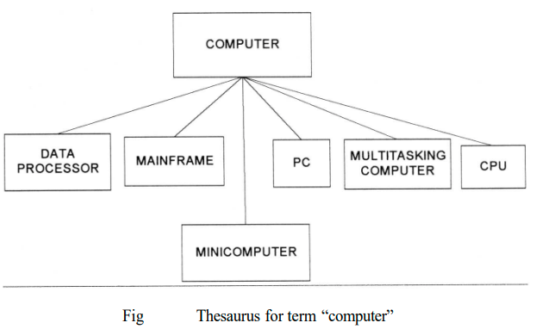
Concept / Thesaurus expansion
It is associated with both Boolean and natural language queries.
Its ability expand the search terms via thesaurus or concept class database tool.
A concept class is a tree structure that expands each meaning of a word into potential concepts

Slide 44
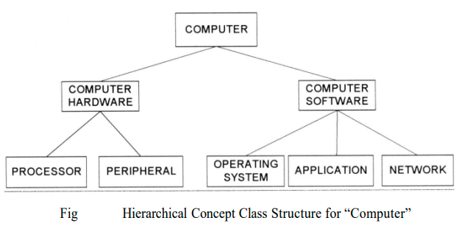
Concept / Thesaurus expansion

Slide 45
Natural Language Queries
Allows a user to enter a prose statement that describes the information that the user wants to find.
Example
Find for me all the items that discuss oil reserves and current attempts to find new oil reserves. Include any items that discuss the international financial aspects of the oil production process. Do not include items about the oil industry in the United States
The likely input for the above example is: oil reserves and attempts to find new oil reserves, international financial aspects of oil production, not United States oil industry

Slide 46
Browse Capabilities
First it performs searching , after it provides which items are of interest and select those to be displayed.
These are two ways
Line item status
Data Visualization

Slide 47
Browse capabilities - Ranking
Ranking
Typically relevance sources are normalized to a value between 0.0 and 1.0.
Whenever the item is relevant to the search statement the highest value is 1.0
Collaborative filtering has been very successful in sites such as AMAZON.COM MovieFinder.com, and CDNow.com in deciding what products to display to users based upon their queries
Actually limiting the no .of items that can be assessed by the no.of lines on a screen
Graphical visualization displays hit items
In some cases color also used in this representation

Slide 48
Browse capabilities - Zoning
It is used in minimizing what an end user needs to review from a hit item is the idea of locality and passed based search and retrieval

Slide 49
Browse capabilities - Highlighting
Most systems allow the display of an item to begin within the item and it allow jumping to the next highlighting.
Highlighting may vary by introducing colors and intensities to indicate the relative importance of an item.

Slide 50
Miscellaneous Capabilities
Vocabulary Browse
Iterative search and search history log
Canned Query

Slide 51
Miscellaneous Capabilities - Vocabulary Browse
It Provides the capability to display in alphabetical stored order words from the document database.
Database stores all unique words in a stored order
The user can enter a word or word fragment and the system will begin to display the around the entered text.
It helps to determine the impact of using fixed or variable length mask on a search item.

Slide 52
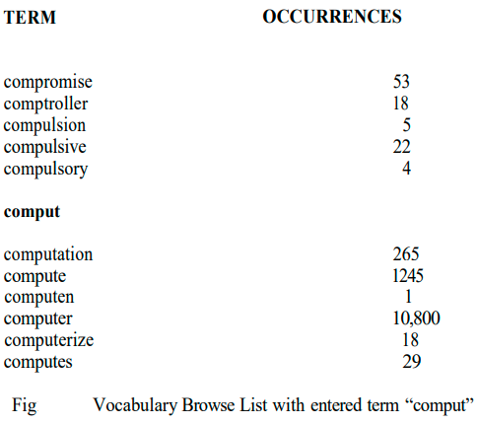

Slide 53
Miscellaneous Capabilities - Iterative search and search history log
The process of refining the results of a previous search to focus on relevant items is called iterative search.
This also applies when a user uses relevance feedback to enhance a previous search.

Slide 54
Miscellaneous Capabilities - Canned Query
The capability of query and store it to be retrieved and executed during a later user session is called canned or stored queries
It allows a user to create and refine a search that focuses on the user’s general area of internet one time and then retrieve data that is currently needed.

Slide 55
Z39.50 and WAIS Standards
Z39.50 does not specify an implementation
Its used to communicate between applications
Communications between computer to computer for database searching and record retrieval.
WAIS(Wide Area Information Service) is the de facto standard for search environments on the internet.
It was developed by Apple, Thinking Machines and Dow Jones
The original idea was to create a program that would acts as a personal librarian .
It is an internal system in which specialized subject databases are created at multiple server locations, keep track of by a directory of servers at one location , and made accessible for searching by users with WAIS

